Slide 1
Word Vectors - Word2vec
Natural Language Processing
(based on revision of Chris Manning Lectures)

Slide 2
Word Representations

Slide 3
Suggested Readings
https://web.stanford.edu/~jurafsky/slp3/6.pdf (vector semantics and embeddings)
Efficient Estimation of Word Representations in Vector Space (original word2vec paper)

Slide 4
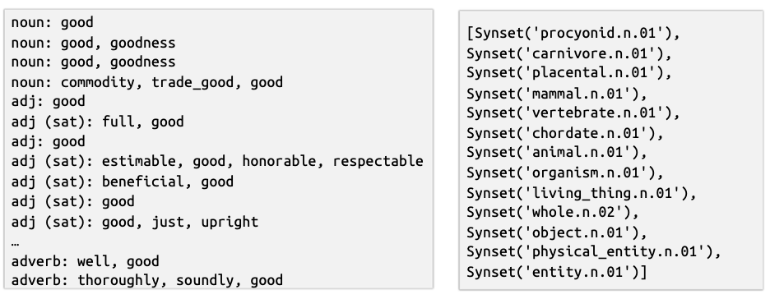
How do we represent the meaning of a word?
Common NLP solution: Use, e.g., WordNet, a thesaurus containing a list of synonyms set and hypernyms (“is a” relationships).
E.g., synonyms set containing “good”:
E.g., hypernyms of “panda”

Slide 5
Problems with solutions like WordNet
Missing context
E.g., “step on shit”, “shit is gonna happen”, “this is real shit”
Missing new meanings of words
E.g., wicked, badass, wizard, ninja
Impossible to keep up-to-date forever!
Requires human labor to maintain
Cannot compute accurate word similarity -> next slide

Slide 6
Word similarity
Naively, words can be represented by one-hot vectors:
motel = [0 0 0 0 0 0 0 1 0 0 0 ]
hotel = [0 1 0 0 0 0 0 0 0 0 0 ]
These two vectors are orthogonal
There is no natural notion of similarity for one-hot vectors
Vector dimension = number of words (V) (e.g., 500,000)
Solution?
Rely on WordNet to get similarity
Incompleteness, difficult to maintain forever
Instead, learn to encode similarity in the vectors

Slide 7
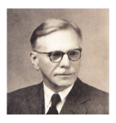
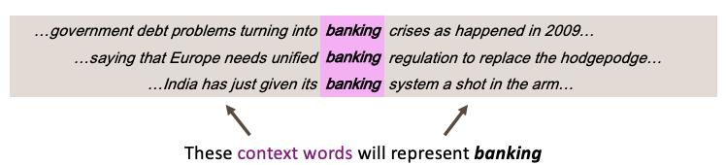
Word similarity
How to encode similarity?
Distributional semantics: A word’s meaning is given by the words that frequently appear close-by
“You shall know a word by the company it keeps” (J.R. Firth 1957: 11)
“You are who you associate with” (Will Smith)
One of the most successful ideas of modern NLP!
When a word w appears in a text, its context is the set of words that appear nearby (within a fixed size window)

Slide 8
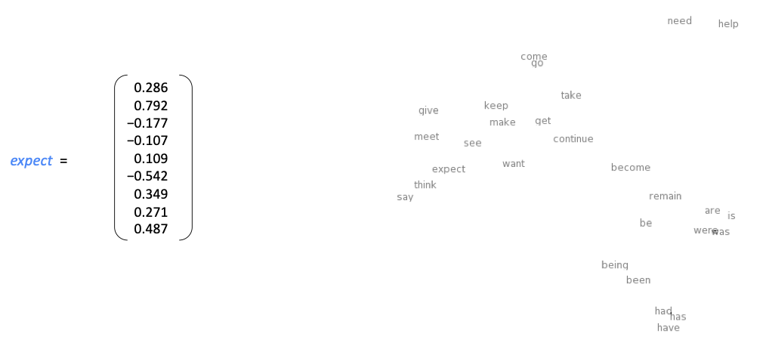
Word vectors

Slide 9
Word2Vec

Slide 10

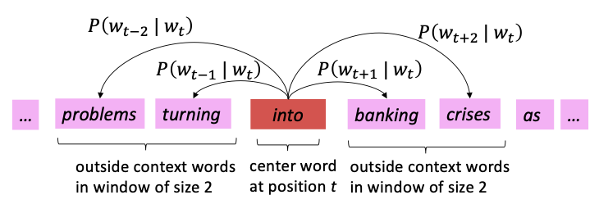
Word2vec [Mikolov et al., NeuroIPS 2013]
Word2vec is an initial framework for learning word vectors
We got large corpus of text
Go through each position t in the text, which has a center word c, and context (“outside”) words o
Calculate the probability of o given c (or vice versa)
Gradient descent to maximize this probability
Example windows for
Efficient Estimation of Word Representations in Vector Space, Mikolov et al., 2013, https://arxiv.org/pdf/1301.3781.pdf

Slide 11
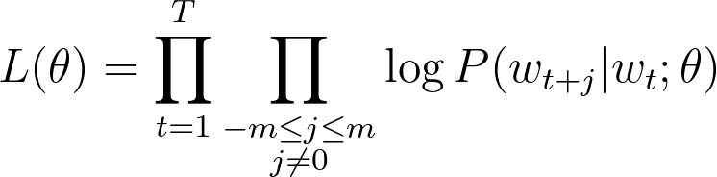
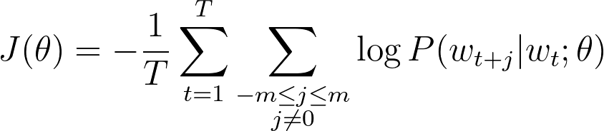
Word2vec: Objective Function
For each position t = 1,...T, predict context words within a window of fixed size m, given center word w_{j} , the likelihood is
The objective function J(θ) is the average negative log likelihood:

Slide 12

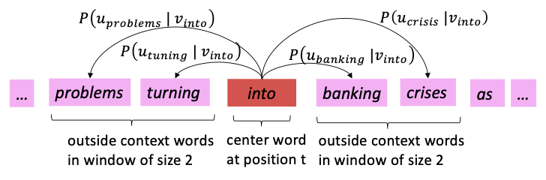
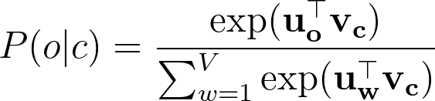
Word2vec: Objective Function
How to calculate
Use two vectors per word w:
v_{w} when w is a center word
u_{w} when w is a context word
Then for a center word c and a context word o:

Slide 13
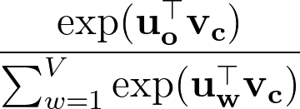

Word2vec: Training procedure
For each epoch:
Sample mini-batch of windows
For each window:
Calculate the probability of the context words given the center words
For each context word, calculate the probability
Calculate loss (which is simply -log of the probability ) (useful for monitoring)
Calculate the gradient of the center word and the outside word in respect to the loss (two gradients)
Sum all the gradients and loss within the window
Sum all the gradients (final gradients) and sum all the loss (final loss) across all windows divided by the batch size
Update the center word vector and outside words vectors

Slide 14
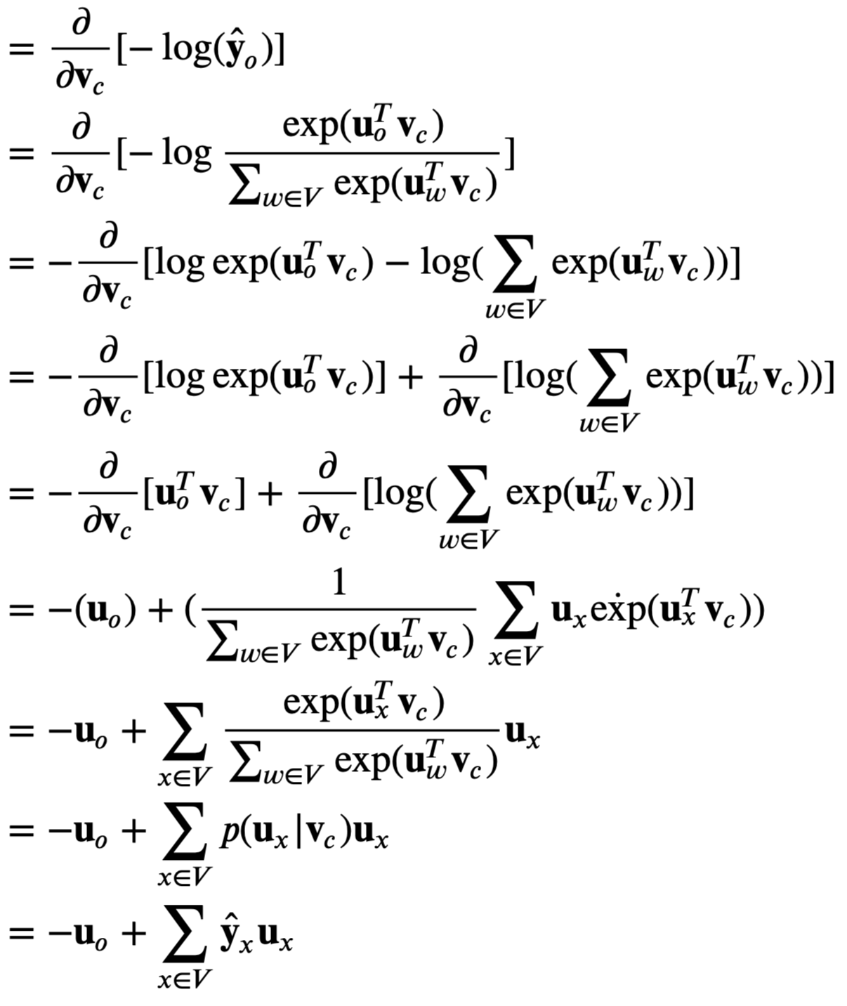
Word2vec: Gradients Computation
This says that the gradient of the loss function w.r.t. the center word is equal to the difference between the observed representation of the outside context word and the expected word according to our model
We still need to find gradients for outside vectors u (Assignment 2)

Slide 15
Word2vec: Gradients Computation
This says that the gradient of the loss function w.r.t. the center word is equal to the difference between the observed representation of the outside context word and the expected word according to our model
We still need to find gradients for outside vectors u (Assignment 2)

Slide 16
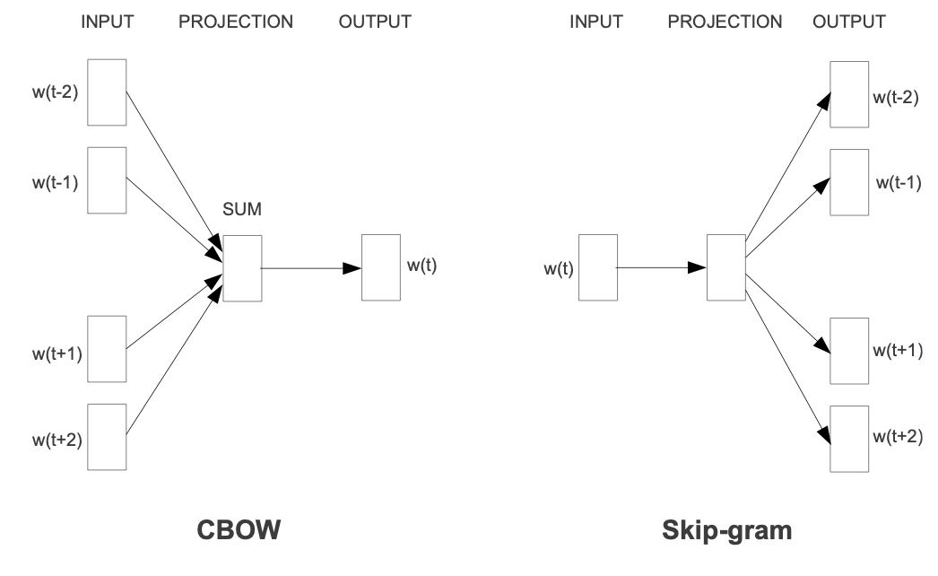
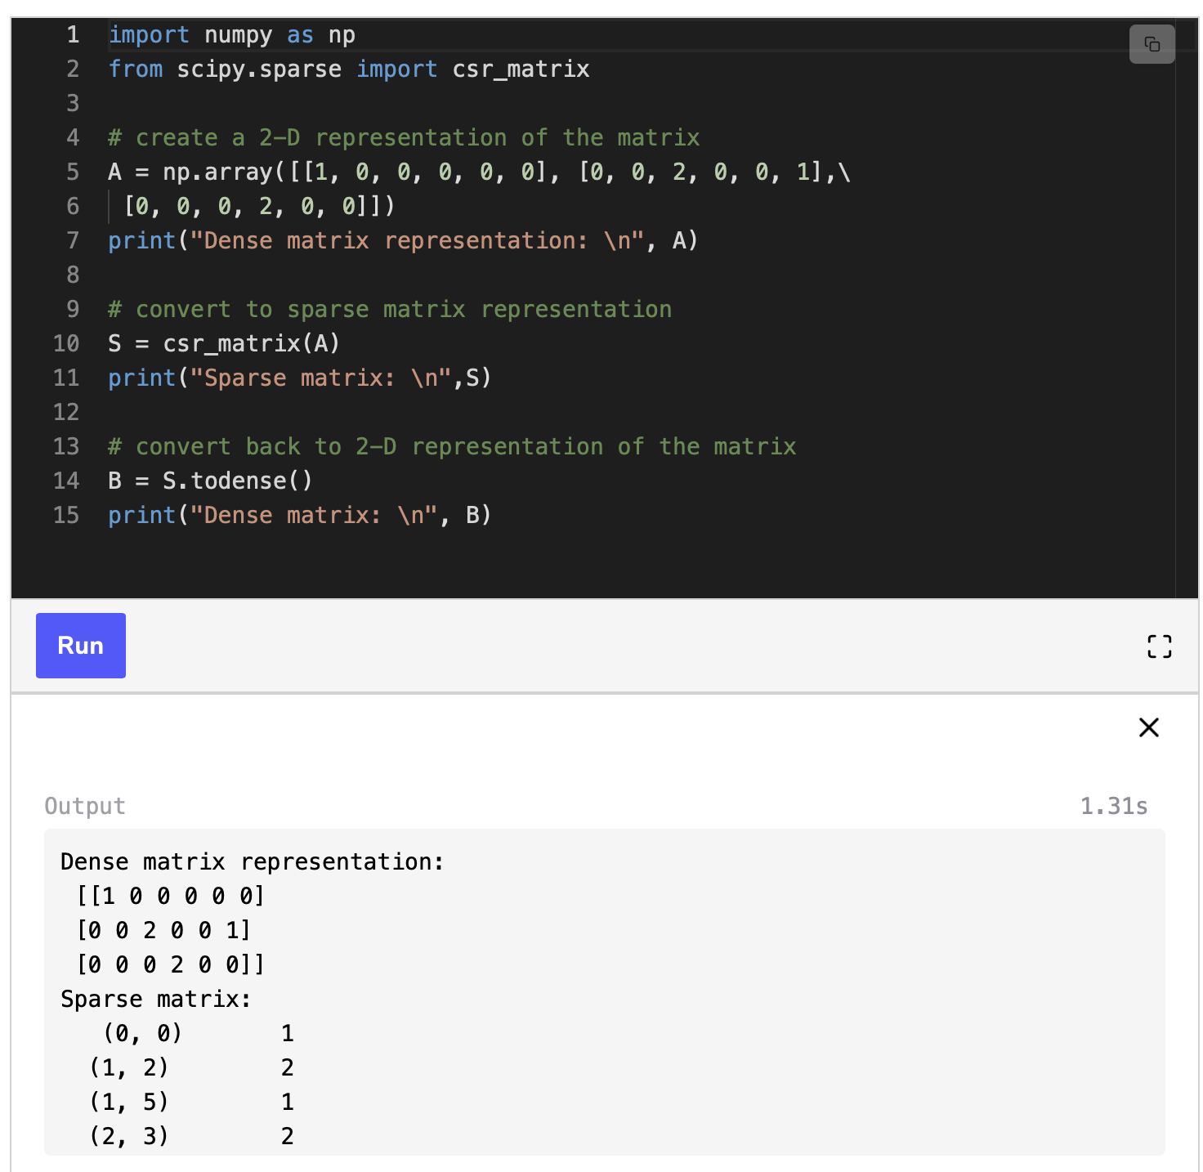
Word2vec: More Details
Why two vectors -> Easier optimization. Average both at the end.
Two model variants
Skip-grams (SG)
Predict context (“outside”) words given center word
Continuous Bag of Words (CBOW)
Predict center word from (bag of) context words
This lecture so far: Skip-gram model
What we cover so far (naive softmax) is very inefficient due to the large computation cost in the normalization factor
Better approach: Negative sampling (next lecture)
Gradient descent can be costly, since the loss function uses all windows in the corpus (billions!).
Stochastic Gradient Descent instead repeatedly sample windows and update after each one
Require either sparse matrix update or use hashing to avoid inefficient updates since only few words will be updated

Slide 17
Word2vec: Skip-gram vs. CBOW
CBOW (Predict center word given outside words) and Skip-gram (Predict context (“outside”) words given center word) uses the same training procedure.
CBOW is much simpler, this implies a much faster convergence for CBOW than for Skip-gram, in the original paper, CBOW took hours to train, Skip-gram 3 days.
CBOW learns better syntactic relationships between words while Skip-gram is better in capturing better semantic relationships. For the word 'cat':
CBOW would retrieve as closest vectors morphologically like plurals, i.e. 'cats'
Skip-gram would consider morphologically different words (but semantically relevant) like 'dog' much closer to 'cat' in comparison.
Because Skip-gram rely on single word input, it is less sensitive to overfit frequent words (and it's also the reason of the better performances of Skip-gram in capturing semantic relationships).

Slide 18
Word2vec
Demo

Slide 19
Summary
Very ineffective and inefficient to store word meanings in one-hot vectors
Word2vec is the first framework to encode word vectors using nearby words
Comes in two variants: Skip-gram and CBOW
Skip-gram seems better but took longer time to train
Amazingly effective to capture word similarity as seen in the demo
As we can see, the current approach is inefficient given the huge computational cost in the lower term. We shall revisit this using negative samplings instead.
Huge cost!

Slide 20
Announcement
Assignment 1 is out.
Mostly focusing on you getting acquainted with Python if you haven’t already
Also focus on letting you play around with word similarities
Start early if you don’t want to panic!

